Slide 1

Proposed changes to Ofsted and accountability measures
Staff Briefing – February 2025

Slide 2

Why are we here?
The Department for Education (DfE) is consulting on reforms to school accountability and Ofsted inspections.
Two key consultations:
  School accountability reform
  Improving the way Ofsted inspects education
Consultation closes 28 April 2025 – your chance to provide feedback!

Slide 3
Accountability reform – key changes
Introduction of Digital School Profiles – a ‘one-stop shop’ for school information.
New Regional Improvement for Standards and Excellence (RISE) teams for targeted intervention.
Faster intervention process for 'stuck' schools (those graded as requiring improvement or below good over two most recent inspections).
Notes:
‘Stuck’ schools are schools that were graded as requires improvement at their most recent Ofsted inspection, and were also graded as below good at their previous inspection. According to Bridget Phillipson, there are over 600 of them, educating more than 300,000 children.

Slide 4
Digital school profiles
What will they include?
  Ofsted report card
  Up-to-date performance information
  Other relevant school data (for discussion in consultation)
Who will host it? – The DfE
Purpose: More transparency for parents and stakeholders

Slide 5
RISE teams and school intervention
What is RISE?
  Regional teams supporting school improvement (Regional Improvement for Standards and Excellence). The DfE is investing £20m, with up to £100,000 per school for specialist support.
Intervention process:
  Special measures schools = structural intervention (academy conversion or trust transfer).
  Until Sept 26: schools requiring significant improvement also receive structural intervention.
  From Sept 2026: significant improvement schools receive mandatory targeted intervention from RISE teams. If no progress in 18 months, structural intervention follows.
  ‘Stuck’ schools will receive mandatory intervention from a RISE team.

Slide 6
Proposed changes to Ofsted
New report card format
  More detailed judgements across up to 11 areas.
  Proposed areas: leadership and governance, curriculum, developing teaching, achievement, behaviour and attitudes, attendance, personal development and wellbeing, safeguarding, inclusion, early years in schools (where applicable), sixth form in schools (where applicable).
  Areas graded as Causing Concern, Attention Needed, Secure, Strong or Exemplary.
  Safeguarding will be reported in a separate section and is either ‘Met’ or ‘Not met’.

Slide 7
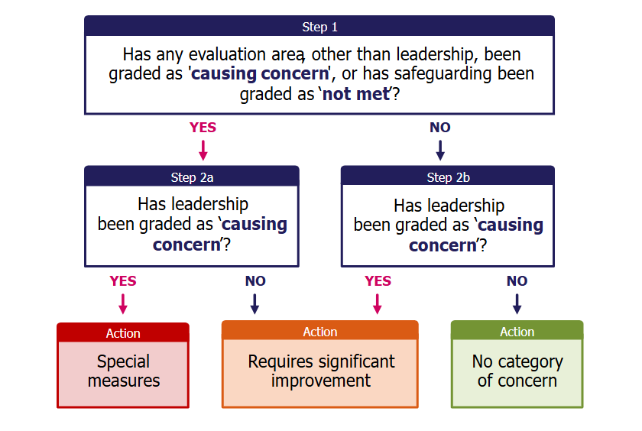
Inspection process changes
No more deep dives – all inspections will be full inspections
Inspection toolkits to be published for clarity and transparency
Schools receiving Causing Concern (Red) or Not Met in safeguarding may face significant intervention

Slide 8
Reactions and questions
Concerns from unions and educators:
  Will the new system reduce or increase stress on staff?
  Does the report card improve clarity or reinforce high-stakes pressures?
  Will it be helpful for parents?
Discussion questions:
  Does this improve accountability?
  How might this impact our school?

Slide 9
Responding to the consultation
Have your say before 28 April 2025
Respond online:
  School accountability reform
  Improving the way Ofsted inspects education

Slide 10
Final thoughts and next steps
We encourage all staff to engage with the consultation
SLT will review potential impacts and share further updates
Questions? Feedback?
Thank you for your time!

Slide 11
Further reading
Consultation: School accountability reform
Consultation document: School accountability reform – school profiles, improvement and intervention
Consultation: Improving the way Ofsted inspects education
Ofsted consultation document
DfE press release: Government sets out plans to target ‘stuck’ schools
Education Secretary speech on new era of school standards
Video: Martyn Oliver, Ofsted’s Chief Inspector, on the Ofsted changes

